Slide 1
Abstract Factory
Object Creational

Slide 2
Intent
Provide an interface for creating families of related or dependent objects without specifying their concrete classes.

Slide 3
Also Known As
Kit

Slide 4
Motivation
Consider a user interface toolkit that supports multiple look-and-feel standards, such as Motif and Presentation Manager.
Different look-and-feels define different appearances and behaviors for user interface "widgets" like scroll bars, windows, and buttons.
To be portable across look-and-feel standards, an application should not hard-code its widgets for a particular look and feel.
Instantiating look-and-feel-specific classes of widgets throughout the application makes it hard to change the look and feel later.

Slide 5
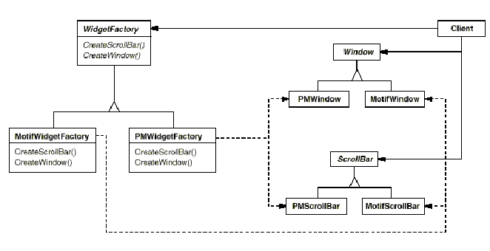
Motivation

Slide 6
Motivation
Define an abstract WidgetFactory class that declares an interface for creating each basic kind of widget.
There's also an abstract class for each kind of widget, and concrete subclasses implement widgets for specific look-and-feel standards.
WidgetFactory's interface has an operation that returns a new widget object for each abstract widget class.
Clients call these operations to obtain widget instances, but clients aren't aware of the concrete classes they're using. Thus clients stay independent of the prevailing look and feel.

Slide 7
Motivation
Each subclass implements the operations to create the appropriate widget for the look and feel.
For example, the CreateScrollBar operation on the MotifWidgetFactory instantiates and returns a Motif scroll bar, while the corresponding operation on the PMWidgetFactory returns a scroll bar for Presentation Manager.
A WidgetFactory also enforces dependencies between the concrete widget classes.
A Motif scroll bar should be used with a Motif button and a Motif text editor, and that constraint is enforced automatically as a consequence of using a MotifWidgetFactory.

Slide 8
Applicability
Use the Abstract Factory pattern when
a system should be independent of how its products are created, composed, and represented.
a system should be configured with one of multiple families of products.
a family of related product objects is designed to be used together, and you need to enforce this constraint.
you want to provide a class library of products, and you want to reveal just their interfaces, not their implementations.

Slide 9
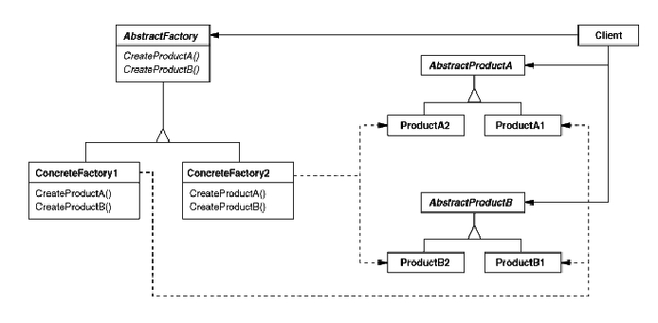
Structure

Slide 10
Participants
AbstractFactory (WidgetFactory)
declares an interface for operations that create abstract product objects.
ConcreteFactory (MotifWidgetFactory, PMWidgetFactory)
implements the operations to create concrete product objects.
AbstractProduct (Window, ScrollBar)
declares an interface for a type of product object.

Slide 11
Participants
ConcreteProduct (MotifWindow, MotifScrollBar)
defines a product object to be created by the corresponding concrete factory.
implements the AbstractProduct interface.
Client
uses only interfaces declared by AbstractFactory and AbstractProduct classes.

Slide 12
Collaborations
Normally a single instance of a ConcreteFactory class is created at run-time. This concrete factory creates product objects having a particular implementation. To create different product objects, clients should use a different concrete factory.
AbstractFactory defers creation of product objects to its ConcreteFactory subclass.

Slide 13
Consequences
Benefits
It isolates concrete classes.
It makes exchanging product families easy.
It promotes consistency among products.
Liabilities
Supporting new kinds of products is difficult.

Slide 14
Implementation
Factories as singletons. An application typically needs only one instance of a ConcreteFactory per product family. So it's usually best implemented as a Singleton.
Creating the products. AbstractFactory only declares an interface for creating products. It's up to ConcreteProduct subclasses to actually create them. The most common way to do this is to define a factory method for each product.

Slide 15
Known Uses
ET++ application framework
ET++ uses the Abstract Factory pattern to achieve portability across different window systems (X Windows and SunView, for example). The WindowSystem abstract base class defines the interface for creating objects that represent window system resources (MakeWindow, MakeFont, MakeColor, for example). Concrete subclasses implement the interfaces for a specific window system. At run-time, ET++ creates an instance of a concrete WindowSystem subclass that creates concrete system resource objects.

Slide 16
Related Patterns
AbstractFactory classes are often implemented with factory methods (Factory Method (121)), but they can also be implemented using Prototype (133).
A concrete factory is often a singleton (Singleton (144)).

Slide 17
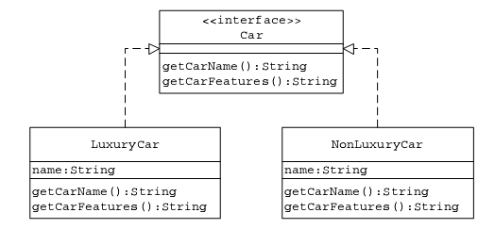
Sample Code
Let us design an application to query the features of different types of vehicles. For simplicity, let us consider two types of vehicles: cars and SUVs. Further, a vehicle can be of either luxury or nonluxury category.

Slide 18
Sample Code
public interface Car {
public String getCarName();
public String getCarFeatures();
}//End of class
public class LuxuryCar implements Car {
private String name;
public LuxuryCar(String cName) {
name = cName;
}
public String getCarName() {
return name;
}
public String getCarFeatures() {
return "Luxury Car Features ";
}
}//End of class

Slide 19
Sample Code
public class NonLuxuryCar implements Car {
private String name;
public NonLuxuryCar(String cName) {
name = cName;
}
public String getCarName() {
return name;
}
public String getCarFeatures() {
return “Non-Luxury Car Features ";
}
}//End of class

Slide 20
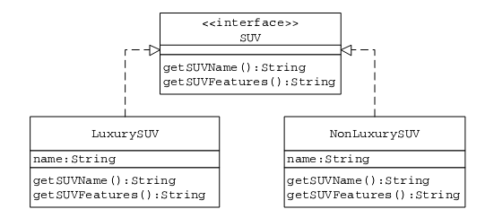
Sample Code
public interface SUV {
public String getSUVName();
public String getSUVFeatures();
}//End of class

Slide 21
Sample Code
public class LuxurySUV implements SUV {
private String name;
public LuxurySUV(String sName) {
name = sName;
}
public String getSUVName() {
return name;
}
public String getSUVFeatures() {
return "Luxury SUV Features ";
}
}//End of class

Slide 22
Sample Code
public class NonLuxurySUV implements SUV {
private String name;
public NonLuxurySUV(String sName) {
name = sName;
}
public String getSUVName() {
return name;
}
public String getSUVFeatures() {
return “Non-Luxury SUV Features ";
}
}//End of class

Slide 23
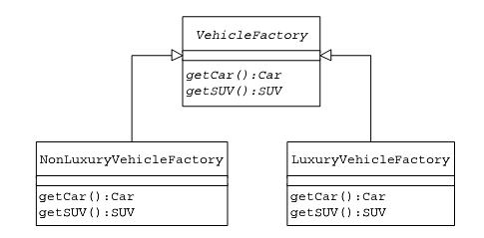
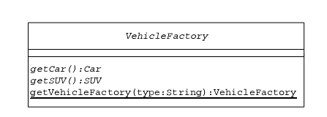
Sample Code

Slide 24
Sample Code
public abstract class VehicleFactory {
public static final String LUXURY_VEHICLE = "Luxury";
public static final String NON_LUXURY_VEHICLE = "Non-Luxury";
public abstract Car getCar();
public abstract SUV getSUV();
public static VehicleFactory getVehicleFactory(String type) {
if (type.equals(VehicleFactory.LUXURY_VEHICLE))
return new LuxuryVehicleFactory();
if (type.equals(VehicleFactory.NON_LUXURY_VEHICLE))
return new NonLuxuryVehicleFactory();
return new LuxuryVehicleFactory();
}
}//End of class

Slide 25
Sample Code
public class LuxuryVehicleFactory extends VehicleFactory {
public Car getCar() {
return new LuxuryCar("L-C");
}
public SUV getSUV() {
return new LuxurySUV("L-S");
}
}//End of class
public class NonLuxuryVehicleFactory extends VehicleFactory {
public Car getCar() {
return new NonLuxuryCar("NL-C");
}
public SUV getSUV() {
return new NonLuxurySUV("NL-S");
}
}//End of class

Slide 26
Client Code
public class AutoSearchUI extends JFrame {
public void actionPerformed(ActionEvent e) {
String searchResult = null;
if (e.getActionCommand().equals(AutoSearchUI.EXIT)) {
System.exit(1);
}
if (e.getActionCommand().equals(AutoSearchUI.SEARCH)) {
//get input values
String vhCategory = objAutoSearchUI.getSelectedCategory();
String vhType = objAutoSearchUI.getSelectedType();
//get one of Luxury or NonLuxury vehicle factories
VehicleFactory vf = VehicleFactory.getVehicleFactory(vhCategory);
if (vhType.equals(AutoSearchUI.CAR)) {
Car c = vf.getCar();
searchResult = "Name: " + c.getCarName() + " Features: " +c.getCarFeatures();
}

Slide 27
Client Code
if (vhType.equals(AutoSearchUI.SUV)) {
SUV s = vf.getSUV();
searchResult = "Name: " + s.getSUVName() + " Features: “+c.getSUVFeatures();
}
objAutoSearchUI.setResult(searchResult);
}
}
…
…
}

Slide 28
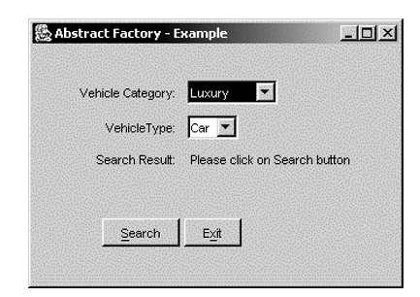
Vehicle Query User Interface

Slide 29
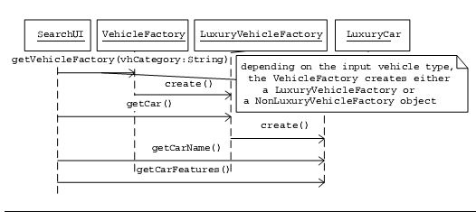
Luxury Car Details Query – Message Flow

